Slide 1
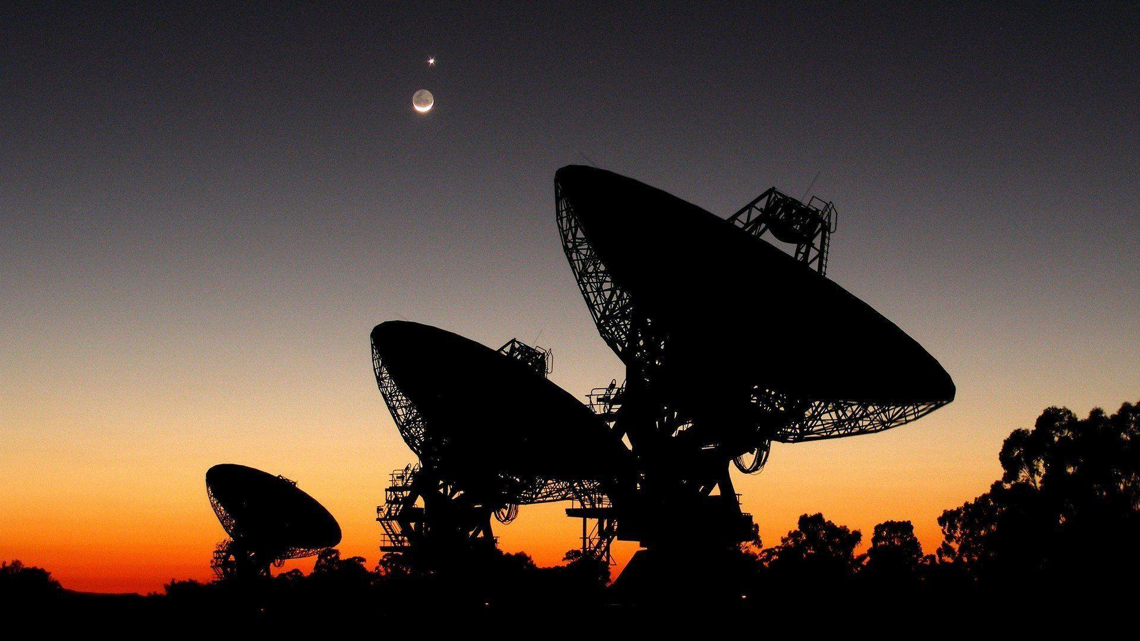

Bayesian Graph Neural Networks, how to optimize a cellular network and provide confidence to our customers
Ericsson Cognitive Software

Slide 2

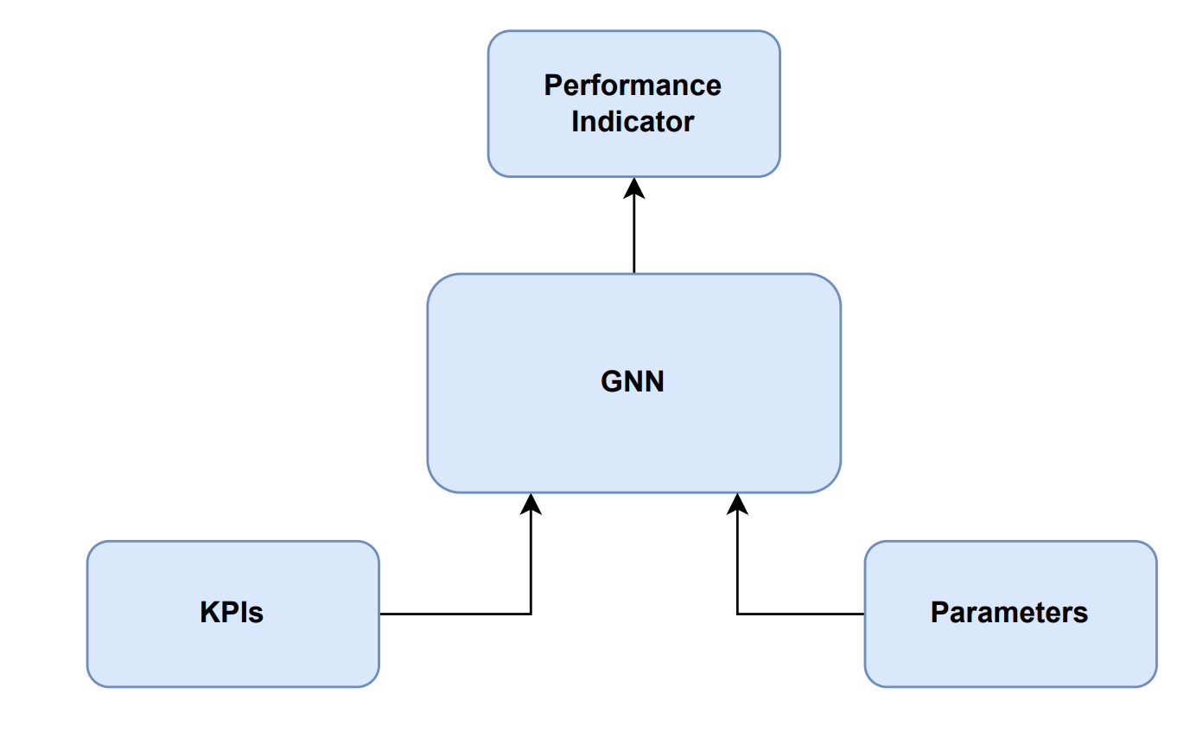
How to optimize a cellular network
Cellular Network
Solution Architecture
Optimization

Slide 3


Uplink Interference
Interference from neighbor cell
Serving eNB
Neighbor eNB
pZeroNominalPusch (p0)
Target uplink transmission power of UE
High p0 = high UE throughput, but also higher interference on neighbors
Alpha (a)
Pathloss compensation factor
High a = higher UE throughput at cell border, higher neighbor interference

Slide 4
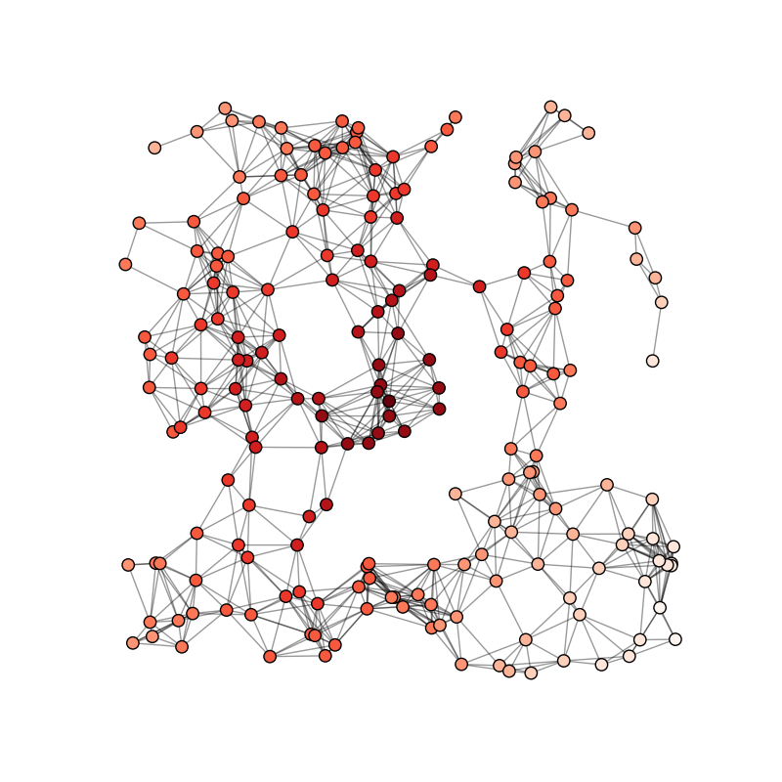

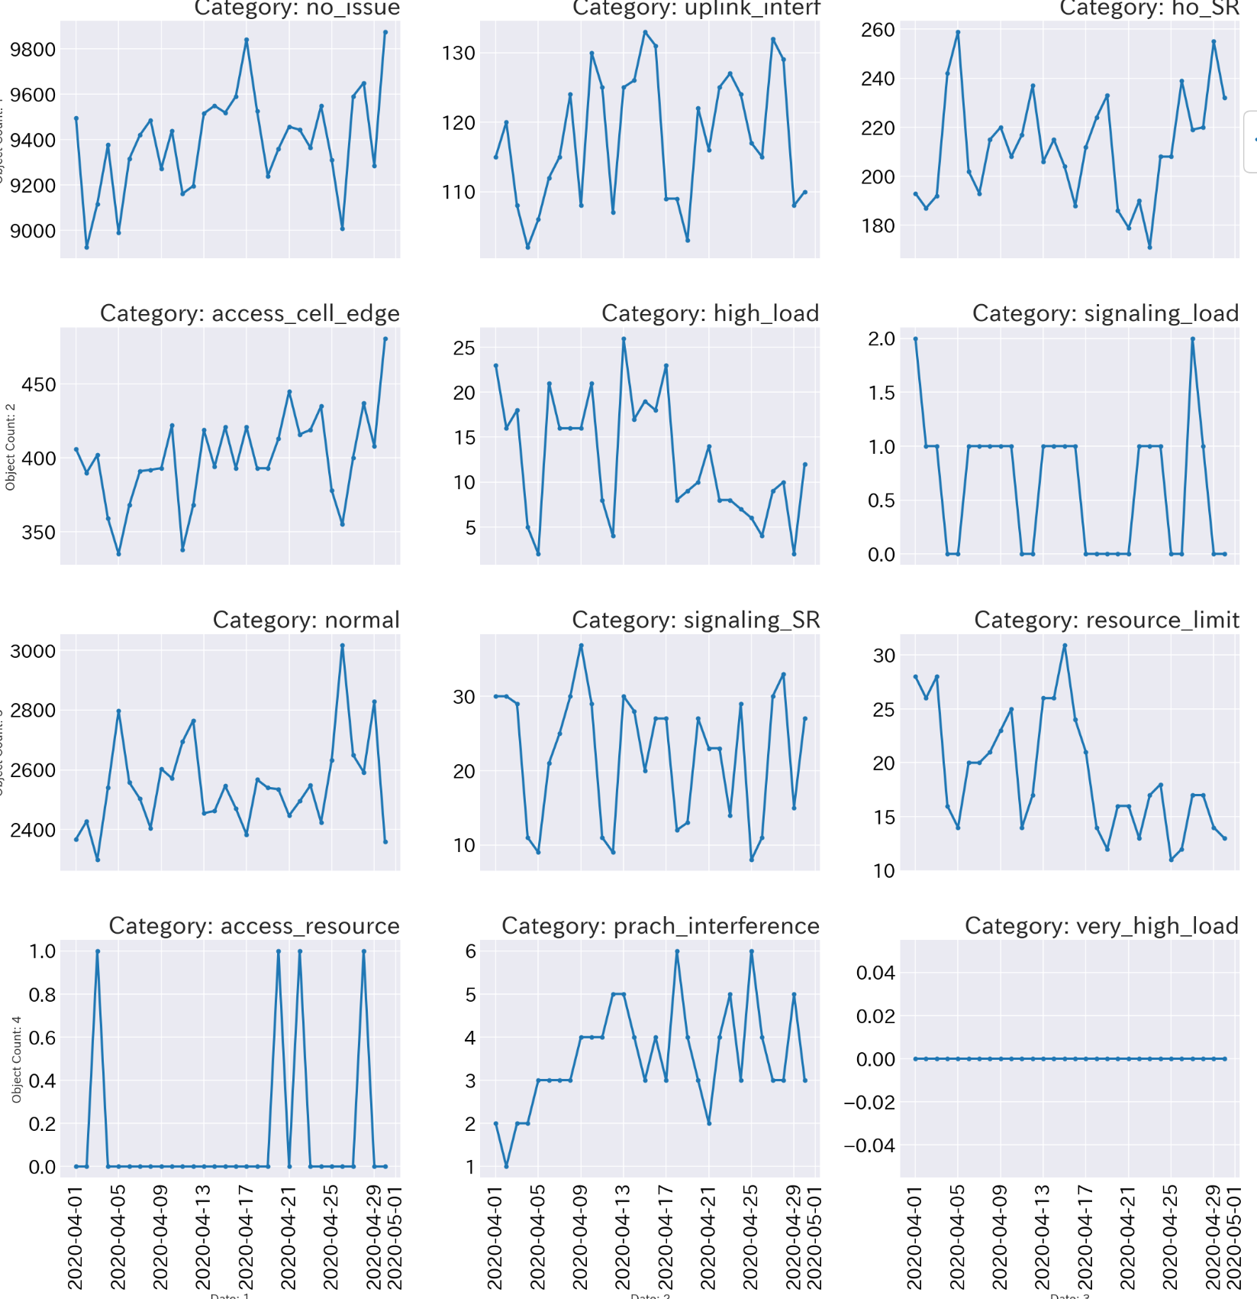
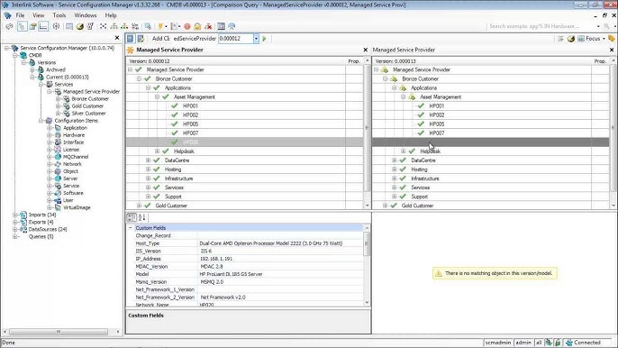


Use GNN as a digital twin
Digital Twin
Apply Graph Neural Network (GNN) to accurately model radio cellular network relations & configurations
Encode Network Data
Generic parameter framework to emulate effect on network performance indicator
Relation information:
- Physical distance
- Traffic exchanged
- Footprint overlap
- Relation parameters
Performance metrics
C
A
D
E
Configuration
F
B
Accurate modeling of real cellular network behavior
GNN architecture provides a native way of modelling cellular network interactions. The framework being developed will make the optimizer development process very straight forward and intuitive.
Digital Twin
GNN optimizer modelling enable the finding of the optimal configuration without the need of interacting with the live network by emulating radio network performance functionality from real network data

Slide 5
Optimization Framework
Test Configuration
Predicted UL SINR
(Including Performance KPIs)
1. Predict SINR with
current parameters
[-110, 8]
2. Predict SINR with
new parameters
20
[-90, 10]
18
13
Trained GNN Model
[-106, 9]
[-92, 9]
10
15
16
Issue cell
[-80, 8]
17
[-120, 10]
17
Issue cell
[-100, 10]
21
[-103, 10]
8
1. Alter power parameters
20
[-88, 9]
2. Alter power parameters until
predicted SINR is maximized
14

Slide 6
How are our predictions perceived by customers?
Unreliable prediction
Reliable prediction
Lack of confidence

Slide 7
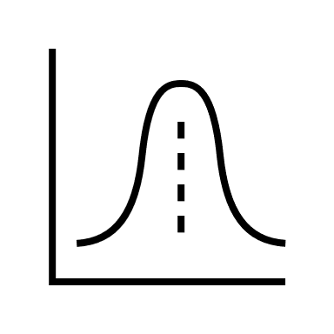
How can we solve the lack of confidence?
Prediction
Give single predictions
Give specific confidence intervals for each prediction
Prediction
Prediction

Slide 8
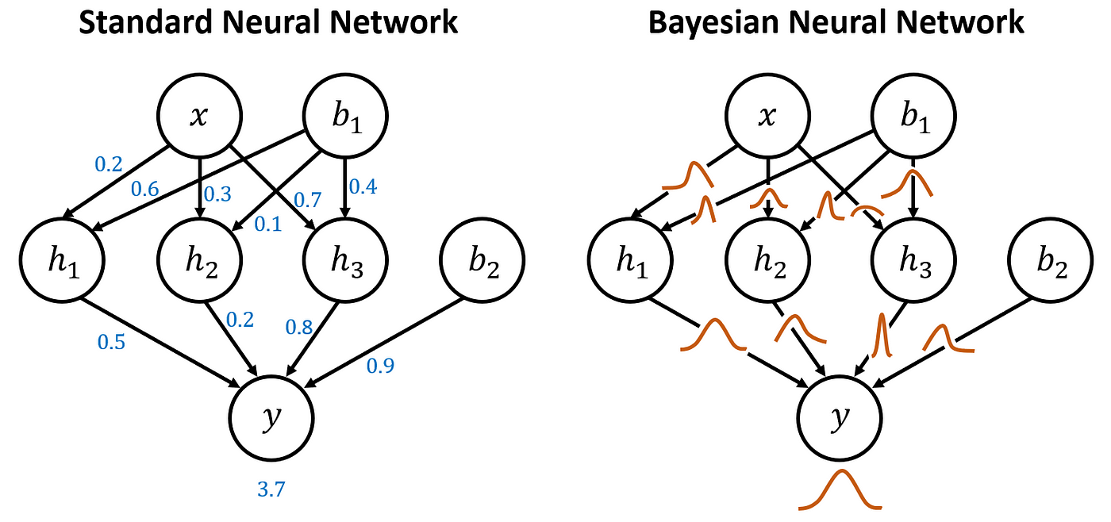
How can we transform our models to give confidence intervals?

Slide 9
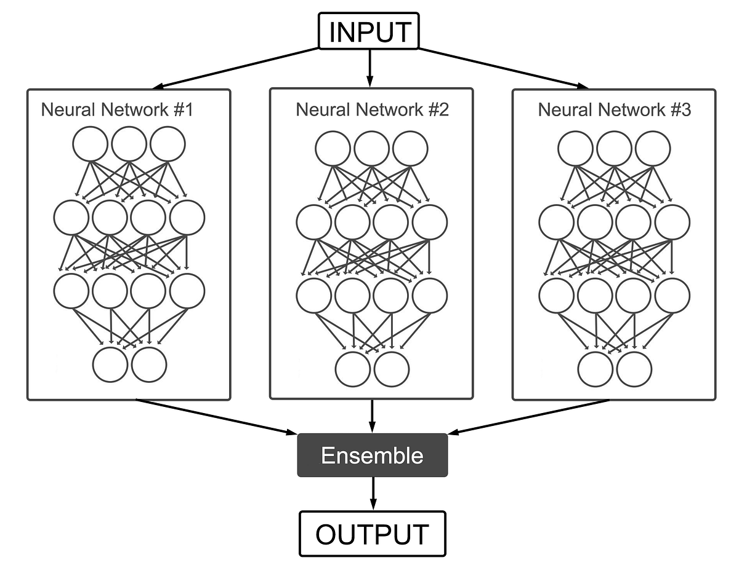
Inference in Bayesian Neural Networks

Slide 10
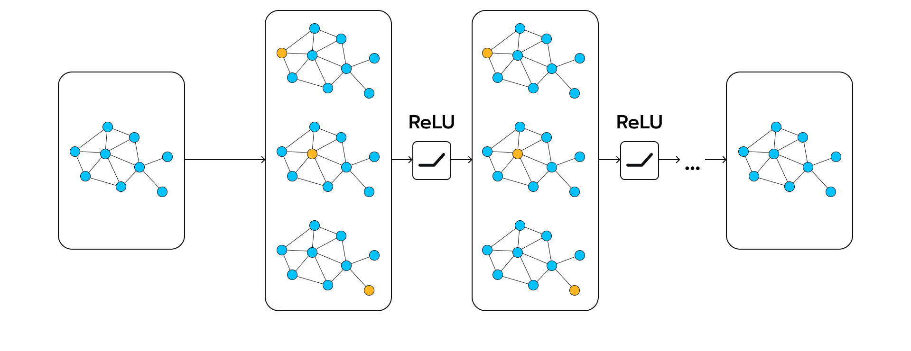
The application to cellular data, Bayesian Graph Neural Network

Slide 11
Optimization Framework v2
Test Configuration
Predicted UL SINR
(Including Performance KPIs)
1. Predict SINR with
current parameters
[-110, 8]
2. Predict SINR with
new parameters
20
[-90, 10]
18
13
[-106, 9]
[-92, 9]
Trained Bayesian GNN Model
10
15
16
Issue cell
[-80, 8]
17
[-120, 10]
17
Issue cell
[-100, 10]
21
[-103, 10]
8
1. Alter power parameters
20
[-88, 9]
2. Alter power parameters until
predicted SINR is maximized
14

